Slide 1


A wind tunnel for kids…
Status Update
April 5, 2012

Slide 2
Activities this week
Android development
Continuing to add functionality to Arduino communication classes via JSON
Enabled ability for app to self-start on boot
Restarting is still an issue on crash
Physical tunnel development
Temperature sensor with led created
Humidity sensor created

Slide 3
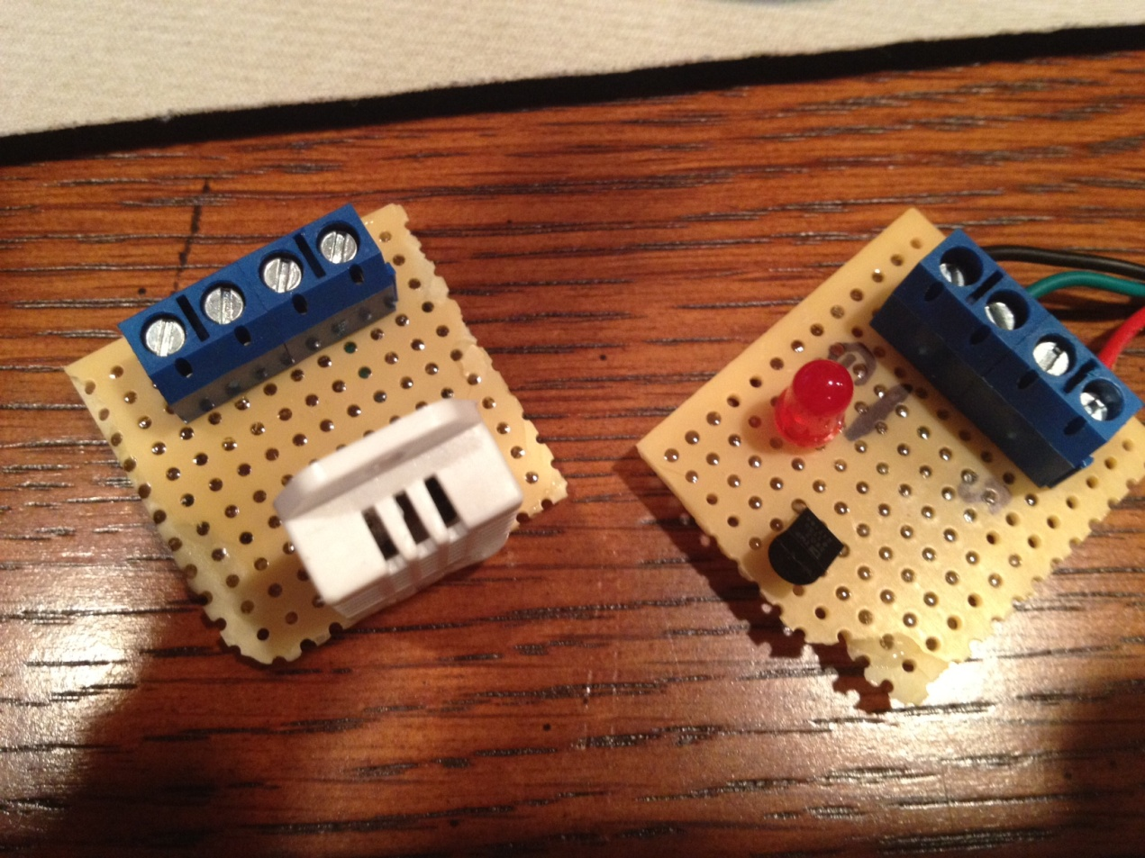
New Sensors
Humidity Sensor and Temperature sensor with LED

Slide 4
Baseline Documentation Metrics
Metric | Value | Notes
# Developer Documents | 116 | SoW, SDP, SRS, SDD, Fall FQT, Javadocs
# Administrator Documents | 0
# Pages | 158
# Status Presentation Slides | 134

Slide 5
Baseline Code Metrics
Metric | Value | Notes
SLOC (Physical) | 9325
SLOC (Logical) | 8158
# Source Files | 114 | File types included: .h, .cpp, .java, .xml, .pde, .ino

Slide 6

Baseline Hardware Metrics
Metric | Value | Notes
# Sensors Prototyped | 3 | Temperature, Humidity, Hall Effect
# Control Elements Prototyped | 2 | Motor Control, LED
# Sensors Integrated | 3 | Temperature, Humidity, Hall Effect
# Control Elements Integrated | 2 | Motor Control, LED

Slide 7


Follow us on Twitter… 7 followers – 47 tweets
@TunnelK
Notes:
Initial social network of choice…

